Slide 1
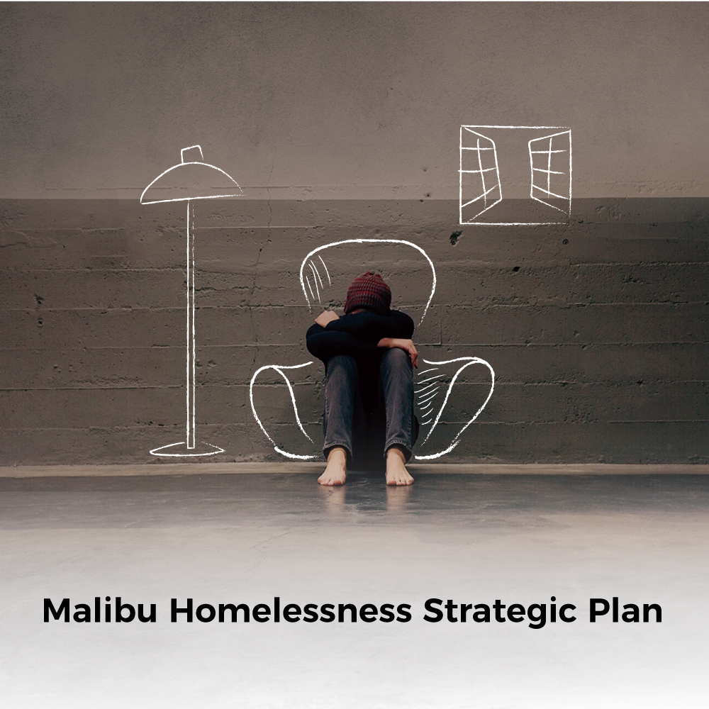


Slide 2
Purpose of strategic plan
Guide, coordinate, and strengthen efforts to address homelessness in Malibu
Align with the regional Homeless Initiative led by Los Angeles County

Slide 3

Planning process
Received a Planning Grant from LA County Homeless Initiative
Retained consultants to facilitate process
Relied heavily on community input
Community Advisory Group of 30 stakeholders
Three half-day planning sessions
Community leader interviews
Community Advisory Group questionnaire
On-line community survey with 572 responses

Slide 4
Our vision of success
Homelessness is declining steadily, as people are finding permanent housing with services as needed, while public safety and health concerns are alleviated.

Slide 5

Guiding principles
Clear plan of action
Work together
Long-term solutions
Field-based model
Permanent housing with supportive services
Safety of the community is a priority
Plan is flexible
Track outcomes
Homelessness is not a crime
Community awareness and involvement
Tailored case management approach
Trust and respect

Slide 6
Goal 1 & Supporting actions
Conduct outreach to landlords
Establish a flexible spending account
Explore the feasibility of developing bridge/permanent housing
Explore creative housing solutions
Reduce the number of people experiencing homelessness in Malibu

Slide 7
Goal 2 & Supporting actions
Utilize volunteers
Temporary housing on Red Flag days
Encampment Management Initiative
Increase access to sanitation facilities
Mitigate potential impacts from the homeless meal program
Explore safe parking opportunities
Utilize peer advocate group
Prevent and mitigate public health and safety impacts

Slide 8
Goal 3 & Supporting actions
Assist individuals at imminent risk of becoming homeless
Implement an emergency housing fund
Pilot inter-generational affordable housing program
Support policies that reduce impact from short-term rentals on affordable housing
Provide incentives for providing affordable units
Implement programs to prevent homelessness

Slide 9
Goal 4 & Supporting actions
Field-based outreach
Support meals program
Regular communication among partners
Utilize volunteers
Partner with Pepperdine University
Expand access to case management
Incorporate best practices
Create a peer-advocate group
Partner with local businesses
Provide coordinated outreach and access to supportive services

Slide 10
Goal 5 & Supporting actions
Monitor and evaluate the effectiveness of strategy
Community meetings and educational workshops
Create a website and FAQs
Develop a social media strategy
Promote existing hotlines
Increase community awareness of the Malibu homeless initiative.

Slide 11
Goal 6 & Supporting actions
Housing voucher rules and restrictions
Criminal justice system
Mental health services
Effectiveness of programs in LA County
Funding for preventing and ending homelessness
Advocate for systemic changes to strengthen efforts to prevent and reduce homelessness

Slide 12
Goal 7 & Supporting actions
Establish Working Group to oversee implementation of the strategy
Increase the City’s capacity to address homelessness in Malibu
Align the Malibu program with the LA County Homeless Initiative
Coordinate with nearby cities on shared strategies
Develop governance structure to support implementation of the plan

Slide 13
Performance measures
Number of people experiencing homelessness
Number of homeless that are off the streets
Number of Sheriff Department calls for services
Number of known encampments
Number of residents prevented from becoming homeless
Number of homeless who consent to services

Slide 14
QUESTIONS???

