Slide 1





City of Malibu
Malibu Fire Rebuild Updates
January 26, 2026
Notes:
Good afternoon, Mayor and City Council. Thank you for the opportunity to present tonight. I’ll provide a brief update on fire rebuild permits and the progress of rebuilding efforts here in Malibu.

Slide 2
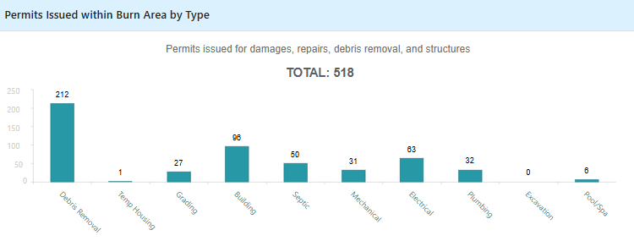
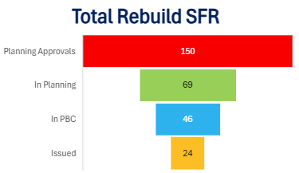
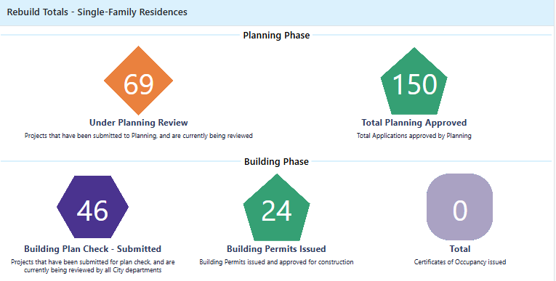
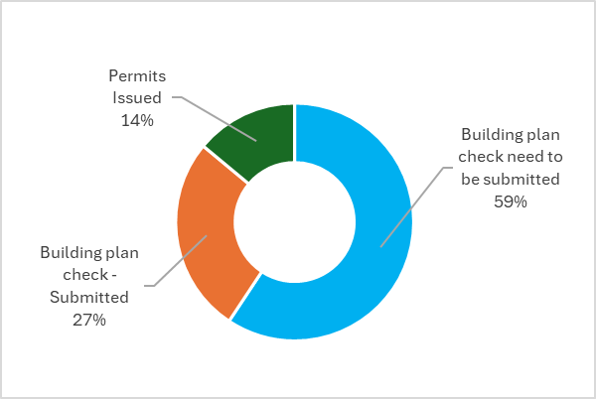
Malibu Fire Rebuild Dashboard Updates
519
150
69
46
7 (since last council meeting)
3
24
14%
3
2
60%
26%
3
Notes:
As of today, we have issued 519 building permits.
For Single-Family Residences, we have 69 projects under Planning Review, 150 total applications approved by planning, 197 approved planning entitlements, 46 projects submitted for building plan check, and 24 building permits issued.
We are expecting few more by the end of this week.

Slide 3

Malibu Fire Rebuild Center Visitors (Opened March 10, 2025)
Total Rebuild Appointments (since opening):
2,018
45
Average per week (since opening):

Slide 4
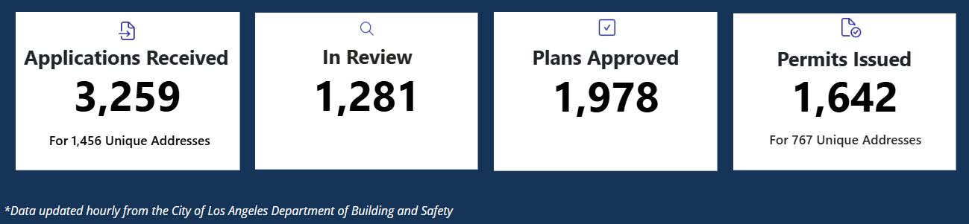
City of LA Palisades Fire Rebuild Updates
Total structures destroyed: 6,837 (this includes home, residential buildings, commercial properties, and other structures)

Slide 5
📜 LA County Code – Title 26, Section 110.2.3.6 (Building Code)
SECTION 110.2.3.6
When the proposed work involves the replacement of structures destroyed by causes other than landslide, settlement, or slippage, and the permit applicant was the owner of the property at the time of the loss, their immediate heir(s), or their authorized representative, and the application for a permit under this Section is filed no later than ten (10) years following the date of the loss.

Slide 6
Sale or Transfer of Property
Sale or Transfer of Property – Rebuild Rights
Sale of property does not automatically terminate rebuild rights
Rebuild rights may be exercised by an authorized representative, including after sale
Authorization must be documented and recorded to ensure continuity
Affidavit Requirement (LACBC §110.2.3.6)
Affidavit of Authorized Representative required (Including Sale or Transfer of Property)
Affidavit must be recorded prior to issuance of building permits
Ensures compliance, transparency, and alignment with Los Angeles County Building Code

Slide 7
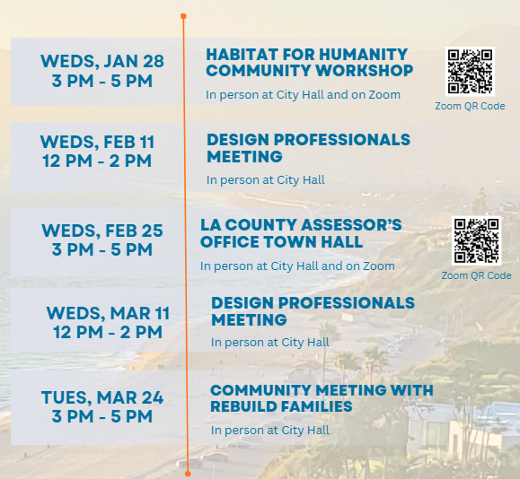
Upcoming Rebuild Events & Workshops
Notes:
This Wednesday, Jan 28, 3 PM - 5 PM in the Council Theater, Habitat for Humanity will be here to provide a presentation on their programs designed to support families rebuilding after the Palisades Fire.

